Slide 1

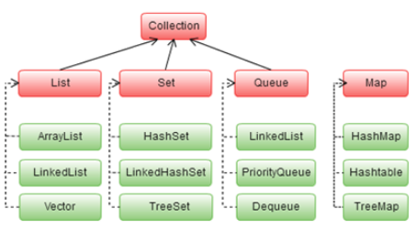

Java Bootcamp 2018
Class 4:

Slide 2
Java Bootcamp 2018 - Class 4: Arrays, Generics and Collections
Exercice
You have a bag with 100 random numbers. You’re asked to find a number which is bigger than every number in the bag. How would you solve it?

Slide 3
Java Bootcamp 2018 - Class 4: Arrays, Generics and Collections
Which Java collections are you familiar with?
Arrays
Map
Dequeue
List
Queue
Set
When to use each?

Slide 4
Java Bootcamp 2018 - Class 4: Arrays, Generics and Collections
Arrays
int[] arrayRef = new int[5];
All data initialized to its value per defect
All data is the same type
Fixed length
length property that gives the number of elements of the Array
Can be initialized when declared
Point[] pointArray = {new Point(1,2), new Point(3,4)};

Slide 5
Java Bootcamp 2018 - Class 4: Arrays, Generics and Collections
Arrays
Arrays are Java objects → their names are their reference
Can grow or shrink upon reassignment
int [] arr = new int[5];
int bArr [] = new int[3];
bArr = arr;
//now both are pointing to same array and have a length of 5

Slide 6
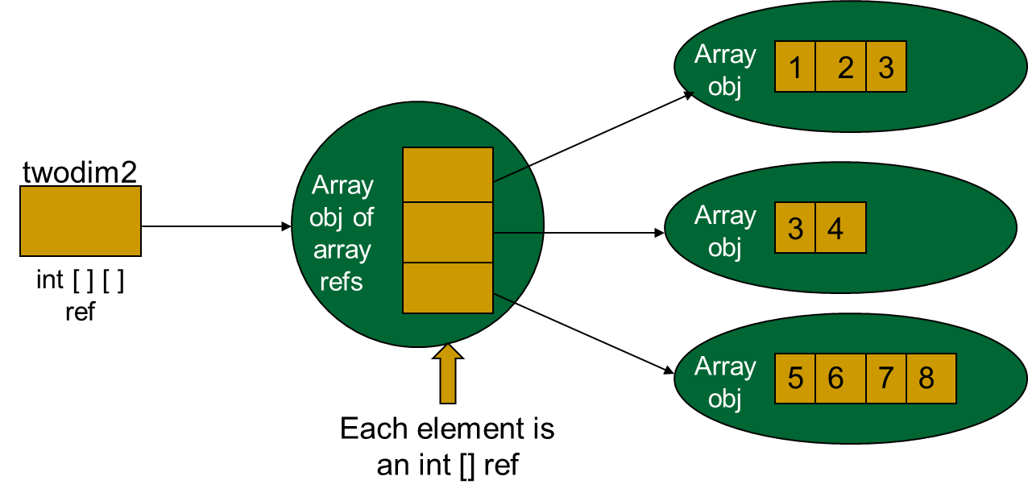
Java Bootcamp 2018 - Class 4: Arrays, Generics and Collections
Arrays
Two-dimensional Array
int [][] twodim2 = {{1,2,3}, {3,4}, {5,6,7,8}};

Slide 7
Java Bootcamp 2018 - Class 4: Arrays, Generics and Collections
Generics
Enables types (classes/interfaces) to be parameters when defining classes, interfaces and methods
Allow reuse of same code with different inputs
type parameters instead of values (formal parameters)
Stronger type checks at compile time
javac applies strong type checking to generic code, issues errors if violating code safety
Enabling programmers to implement generic algorithms
which work on collections of different types

Slide 8
Java Bootcamp 2018 - Class 4: Arrays, Generics and Collections
Generics
Elimination of casts
The following code snippet without generics requires casting:
List list = new ArrayList();
list.add("hello");
String s = (String) list.get(0);
When re-written to use generics, the code does not require casting:
List<String> list = new ArrayList<String>();
list.add("hello");
String s = list.get(0);

Slide 9
Java Bootcamp 2018 - Class 4: Arrays, Generics and Collections
Generics
public class Box<T> {
// T stands for "Type"
private T t;
public void set(T t) {
this.t = t;
}
public T get() {
return t;
}
}
Generic class definition:
class name<T1,T2,...,Tn>
The most commonly used type parameter names are:
E - Element (used extensively by the Java Collections Framework)
K - Key
N - Number
T - Type
V - Value
S,U,V etc. - 2nd, 3rd, 4th types

Slide 10
Java Bootcamp 2018 - Class 4: Arrays, Generics and Collections
Java Collections framework
Collection/Container: object that groups multiple elements into a single unit
Used to store, retrieve, manipulate data
They usually represent data items from a natural group
Poker hand (collection of cards)
Mail folder (collection of letters)
Telephone directory (mapping of names to phone numbers)

Slide 11
Java Bootcamp 2018 - Class 4: Arrays, Generics and Collections
Java Collections framework
The Java platform includes a Collections framework
Package java.util
Includes:
Collections interfaces → sets, lists, maps
General purpose implementations → primary implementations of the collections interfaces
Legacy implementations → collections from earlier releases (Vector/HashTable)
Special-purpose implementations
Concurrent implementations → highly concurrent use
Wrapper implementations → adding e.g. synchronizations to other implementations

Slide 12
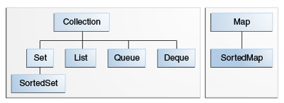
Java Bootcamp 2018 - Class 4: Arrays, Generics and Collections
Core collections interfaces
Hierarchy

Slide 13
Java Bootcamp 2018 - Class 4: Arrays, Generics and Collections
Core collections interfaces - Collection
Group of objects known as its elements
Some allow duplicates, some don’t
Some ordered, some unordered

Slide 14
Java Bootcamp 2018 - Class 4: Arrays, Generics and Collections
Core collections interfaces - Collection
public interface Collection<E> extends Iterable<E> {
// Basic operations
int size();
boolean isEmpty();
boolean contains(Object element);
boolean add(E element); //optional
boolean remove(Object element); //optional
Iterator<E> iterator();
// Bulk operations
boolean containsAll(Collection<?> c);
boolean addAll(Collection<? extends E> c); //optional
boolean removeAll(Collection<?> c); //optional
boolean retainAll(Collection<?> c); //optional
void clear(); //optional
// Array operations
Object[] toArray();
<T> T[] toArray(T[] a);
}

Slide 15
Java Bootcamp 2018 - Class 4: Arrays, Generics and Collections
Core collections interfaces - Iterator
Object that enables you to traverse through a collection and remove elements from it selectively, if desired
To get a collection iterator, call its iterator() method
public interface Iterator<E> {
boolean hasNext();
E next();
void remove(); //optional
}
Iterator<E> _i= collection.iterator();
while (_i.hasNext()) {
E var= _i.Next();
. . . Your code . . .
}

Slide 16
Java Bootcamp 2018 - Class 4: Arrays, Generics and Collections
Core collections interfaces - foreach
for (Object o : collection) {
System.out.println(o);
}

Slide 17
Java Bootcamp 2018 - Class 4: Arrays, Generics and Collections
Core collections interfaces - Set
Collection that cannot contain duplicate elements
Models the mathematical set abstraction
Nothing added to the Collection interface - except no duplicates allowed

Slide 18
Java Bootcamp 2018 - Class 4: Arrays, Generics and Collections
Core collections interfaces - List
Ordered collection (sometimes called a sequence)
Can contain duplicates
Its user has usually precise control over where in the list each element is inserted and can access by their integer index (position)

Slide 19
Java Bootcamp 2018 - Class 4: Arrays, Generics and Collections
Core collections interfaces - List
public interface List<E> extends Collection<E> {
// Positional access
E get(int index);
E set(int index, E element); //optional
boolean add(E element); //optional
void add(int index, E element); //optional
E remove(int index); //optional
boolean addAll(int index,
Collection<? extends E> c); //optional
// Search
int indexOf(Object o);
int lastIndexOf(Object o);
// Iteration
ListIterator<E> listIterator();
ListIterator<E> listIterator(int index);
// Range-view
List<E> subList(int from, int to);
}

Slide 20
Java Bootcamp 2018 - Class 4: Arrays, Generics and Collections
Core collections interfaces - Queue
Used to hold elements prior to processing
Additional insertion, extraction and inspection operations
public interface Queue<E> extends Collection<E> {
E element(); //throws
E peek(); //null
boolean offer(E e); //add - bool
E remove(); //throws
E poll(); //null
}

Slide 21
Java Bootcamp 2018 - Class 4: Arrays, Generics and Collections
Core collections interfaces - Dequeue
Used to hold elements prior to processing
Additional insertion, extraction and inspection operations

Slide 22
Java Bootcamp 2018 - Class 4: Arrays, Generics and Collections
Core collections interfaces - Map
Object that maps keys to values
Cannot contain duplicate keys
Each key can map to almost one value
Are no true collections

Slide 23
Java Bootcamp 2018 - Class 4: Arrays, Generics and Collections
Core collections interfaces - Map
public interface Map<K,V> {
// Basic operations
V put(K key, V value);
V get(Object key);
V remove(Object key);
boolean containsKey(Object key);
boolean containsValue(Object value);
int size();
boolean isEmpty();
// Bulk operations
void putAll(Map<? extends K, ? extends V> m);
void clear();
// Collection Views
public Set<K> keySet();
public Collection<V> values();
public Set<Map.Entry<K,V>> entrySet();
// Interface for entrySet elements
public interface Entry {
K getKey();
V getValue();
V setValue(V value);
}
}

Slide 24
Java Bootcamp 2018 - Class 4: Arrays, Generics and Collections
Core collections interfaces - Sorted interfaces
SortedSet
maintains elements in ascending order
additional ops to take advantage of ordering
SortedMap
maintains mappings in ascending order
Dictionaries

Slide 25
Java Bootcamp 2018 - Class 4: Arrays, Generics and Collections
Core collections interfaces - SortedSet
public interface SortedSet<E> extends Set<E> {
// Range-view
SortedSet<E> subSet(E fromElement, E toElement);
SortedSet<E> headSet(E toElement);
SortedSet<E> tailSet(E fromElement);
// Endpoints
E first();
E last();
// Comparator access
Comparator<? super E> comparator();
}

Slide 26
Java Bootcamp 2018 - Class 4: Arrays, Generics and Collections
Core collections interfaces - SortedMap
public interface SortedMap<K, V> extends Map<K, V>{
SortedMap<K, V> subMap(K fromKey, K toKey);
SortedMap<K, V> headMap(K toKey);
SortedMap<K, V> tailMap(K fromKey);
K firstKey();
K lastKey();
Comparator<? super K> comparator();
}

Slide 27
Java Bootcamp 2018 - Class 4: Arrays, Generics and Collections
Core collections interfaces - Sorted interfaces
A list may be order as follows:
Collections.sort(l);
If the list contains Strings, alphabetical order
If the list contains Date elements, chronological order
How does this happen? → they both implement the Comparable Interface
Natural ordering for a class which allows automatic ordering

Slide 28
Java Bootcamp 2018 - Class 4: Arrays, Generics and Collections
Core collections interfaces - Sorted interfaces
Class | Natural Ordering
Byte | Signed numerical
Character | Unsigned numerical
Long | Signed numerical
Integer | Signed numerical
Short | Signed numerical
Double | Signed numerical
Float | Signed numerical
BigInteger | Signed numerical
BigDecimal | Signed numerical
Boolean | Boolean.FALSE < Boolean.TRUE
File | System-dependent lexicographic on path name
String | Lexicographic
Date | Chronological
CollationKey | Locale-specific lexicographic

Slide 29
Java Bootcamp 2018 - Class 4: Arrays, Generics and Collections
Core collections interfaces - Sorted interfaces
public interface Comparable<T> {
public int compareTo(T o);
}
Compares receiving object with the specified and returns:
negative integer (less than)
0 (equal)
positive integer (bigger than)

Slide 30
Java Bootcamp 2018 - Class 4: Arrays, Generics and Collections
Core collections interfaces - Sorted interfaces
public boolean equals(Object o) {
if (!(o instanceof Name))
return false;
Name n = (Name) o;
return n.firstName.equals(firstName) && n.lastName.equals(lastName);
}
public int hashCode() {
return 31*firstName.hashCode() + lastName.hashCode();
}
public String toString() {
return firstName + " " + lastName;
}
public int compareTo(Name n) {
int lastCmp = lastName.compareTo(n.lastName);
return (lastCmp != 0 ? lastCmp : firstName.compareTo(n.firstName));
}
}
import java.util.*;
public class Name implements Comparable<Name> {
private final String firstName, lastName;
public Name(String firstName, String lastName) {
this.firstName = firstName;
this.lastName = lastName;
}
public String firstName() { return firstName; }
public String lastName() { return lastName; }

Slide 31
Java Bootcamp 2018 - Class 4: Arrays, Generics and Collections
Collections Implementations
Named typically in the form <Implementation-style><Interface>
Interface | Hash Table | Resizable Array | Balanced Tree | Linked List | Hash Table + Linked List
Set | HashSet |  | TreeSet |  | LinkedHashSet
List |  | ArrayList |  | LinkedList
Deque |  | ArrayDeque |  | LinkedList
Map | HashMap |  | TreeMap |  | LinkedHashMap

Slide 32
Java Bootcamp 2018 - Class 4: Arrays, Generics and Collections
Collections Implementations - List
When to use each?
 | ArrayList | LinkedList
Insertion | O(1) | O(1)
Retrieval | O(1) | O(N)
Removal | O(N) | O(N)

Slide 33
Java Bootcamp 2018 - Class 4: Arrays, Generics and Collections
Collections Implementations - Map
When to use each?
 | HashMap | TreeMap | LinkedHashMap
Iteration order | No guarantees | Natural ordering | Insertion-order
Get/Put/Remove/ContainsKey | O(1) | O(log(n)) | O(1)
Null values/keys | allowed | Only values | allowed
Implementation | buckets | Red-black tree | doubled-linked buckets
Synchronized | no | no | no

Slide 34
Java Bootcamp 2018 - Class 4: Arrays, Generics and Collections
Collections Implementations - Set
When to use each?
 | HashSet | TreeSet | LinkedHashSet
Iteration order | No guarantees | Natural ordering | Insertion-order
Get/Put/Remove/ContainsKey | O(1) | O(log(n)) | O(1)
Null values/keys | Maximum 1 | Not allowed | Maximum 1
Memory occupation | Less memory | More memory for links | More memory for comparators

Slide 35
Java Bootcamp 2018 - Class 4: Arrays, Generics and Collections
Collections Implementations
When declaring a List, a Set or a Map, you should use List, Set or Map interface as the datatype instead of the implementing class. This will allow to change the implementation by changing a single line of code

Slide 36
Java Bootcamp 2018 - Class 4: Arrays, Generics and Collections
Any questions?

